Slide 1
Health Insurance Analysis
Nahum Ghebrehiwet

Slide 2
Health Insurance Background
Healthcare costs are one of the largest payments people make in their lifetime.
Healthcare premiums are influenced by a variety of factors.
Learning about these factors can help minimize cost.

Slide 3
Goal
The goal of this project is to analyze how different patient characteristics affect cost
Provide data-driven recommendations on how to minimize the cost of health insurance.

Slide 4
Health Insurance Data
The dataset has over 1,300 patient records
The dataset includes valuable information such as age, sex, BMI, smoker, region, and number of children

Slide 5
Tools and Methods
Python: Cleaning and checking data for errors
SQL: Descriptive statistics
Power BI: Table Visualizations
RStudio: Inferential Statistics

Slide 6
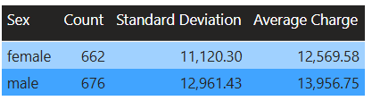
Average Charge by Sex
This table shows the average charge for patients by sex.
Male patients have, on average, higher premiums

Slide 7
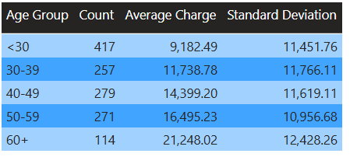
Average Charge by Age
This table shows the average premium for each age group
Older patients have higher charges

Slide 8
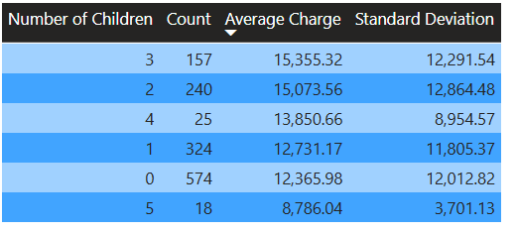
Average Charges by Number of Children
This table shows the average charges for patients by the number of children they have.
There are a very small number of patients with 4 or more children

Slide 9
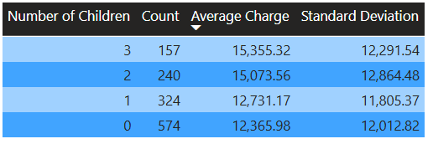
Average Charges by Number of Children Cont.
This table also shows the average charges for patients by the number of children they have.
Removed patients who have more than 3 children

Slide 10
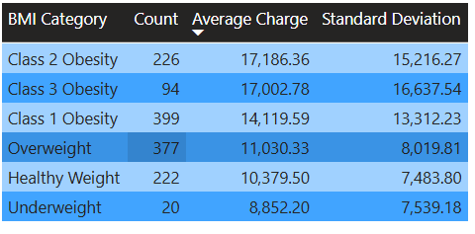
Average Charge by BMI
The table shows the average charge by BMI category
Underweight: BMI < 18.5
Healthy Weight: 18.5 < BMI < 25
Overweight: 25 < BMI < 29
Obesity: BMI > 30
Based on the CDC health guideline

Slide 11
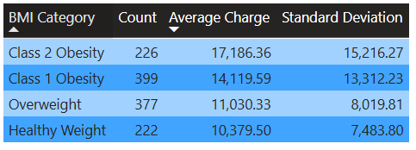
Average Charge by BMI cont.
This table also shows the average charge by BMI category

Slide 12
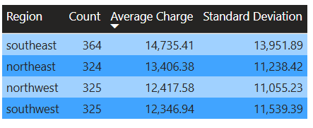
Average Charge by Region
The table shows average charge by region

Slide 13
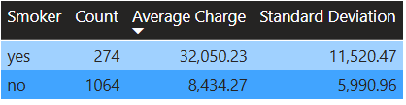
Average Charge by Smoker Status

Slide 14
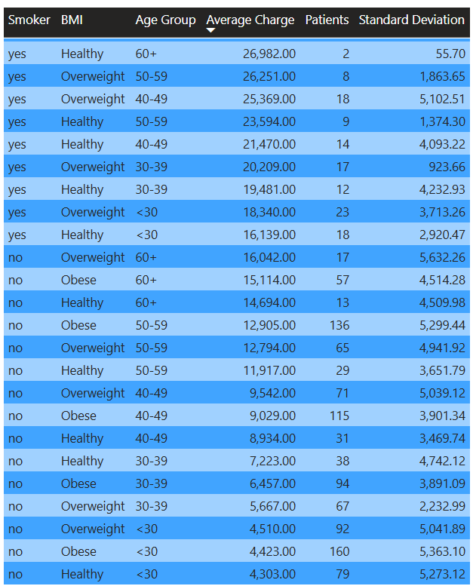
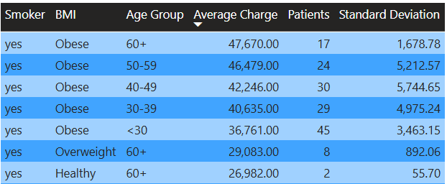
Putting it together

Slide 15
Descriptive Statistics Basic Summary
This basic analysis found certain characteristics of patients that have much higher average charges
Patients 60+ years old
Patients with BMI at or above class 1 obesity
Smokers
Patients with 2 or more children have slightly higher average charges

Slide 16

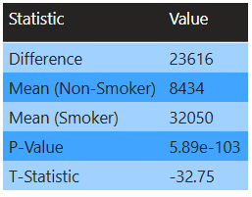

Test for significance age

Slide 17
Recommendations
Provide incentive programs to reduce costs for patient groups with high average charges
ex: Reduced gym membership, nicotine cessation, etc.
Patients can take steps to reduce charges, such as maintaining a weight below obesity and minimizing smoking.

Slide 18
Conclusion
Goal was to analyze how different patient characteristics affect cost
Create potential recommendations to reduce healthcare costs

Slide 19
Limitations
The dataset only includes whether patients smoke or not. It doesn’t show how frequently some patient's smoke.
Very little data on healthy older patients.
Simulated data (to avoid HIPAA violations).

